Slide 1

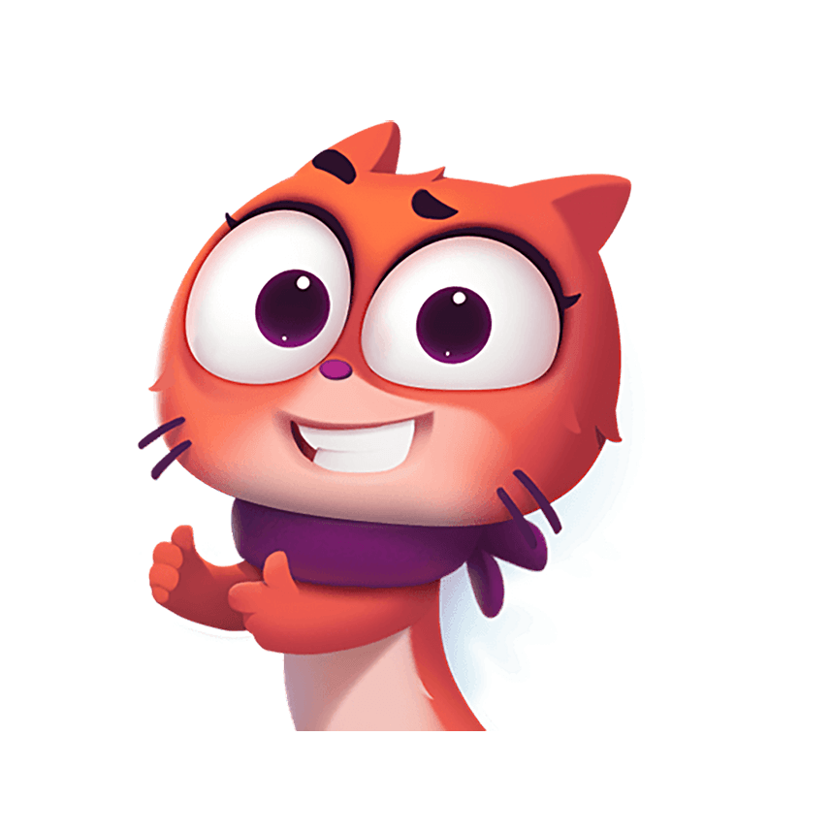
LAST RETRO
GREEN TEAM

Slide 2
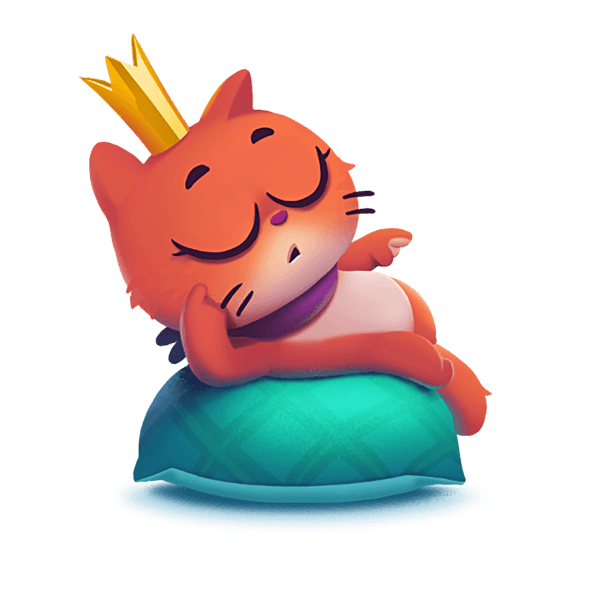
SUPERPOWER
What makes us work as a team?
What do we do differently?
What have we achieved?
Notes:
Ask the team to write down what they think is the superpower of the team. A positive closing of the retrospective.

Slide 3
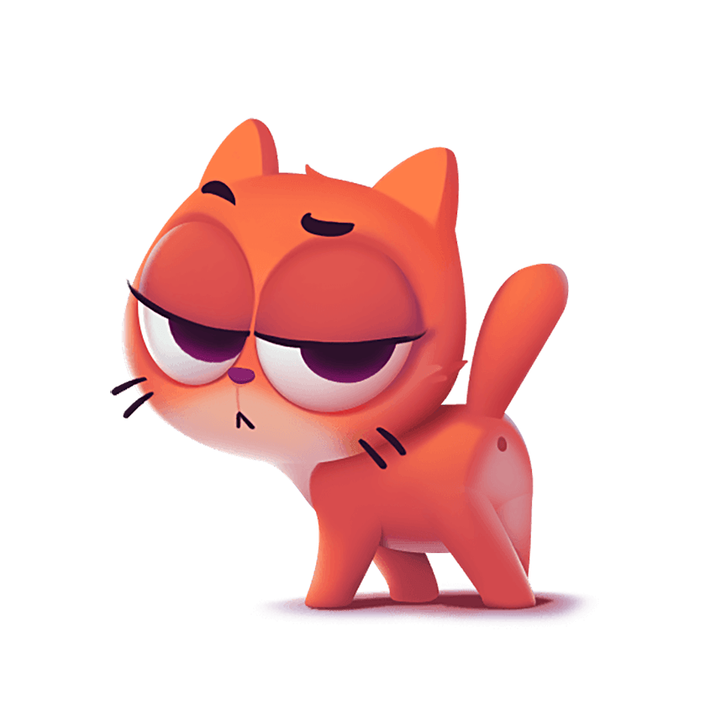
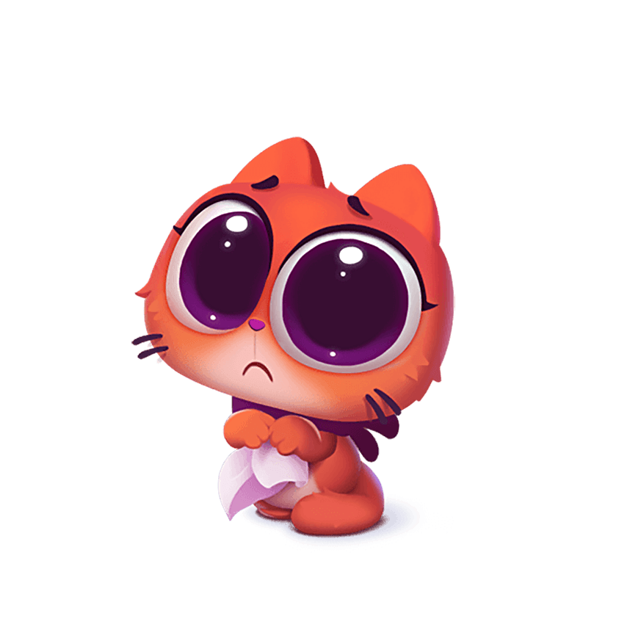
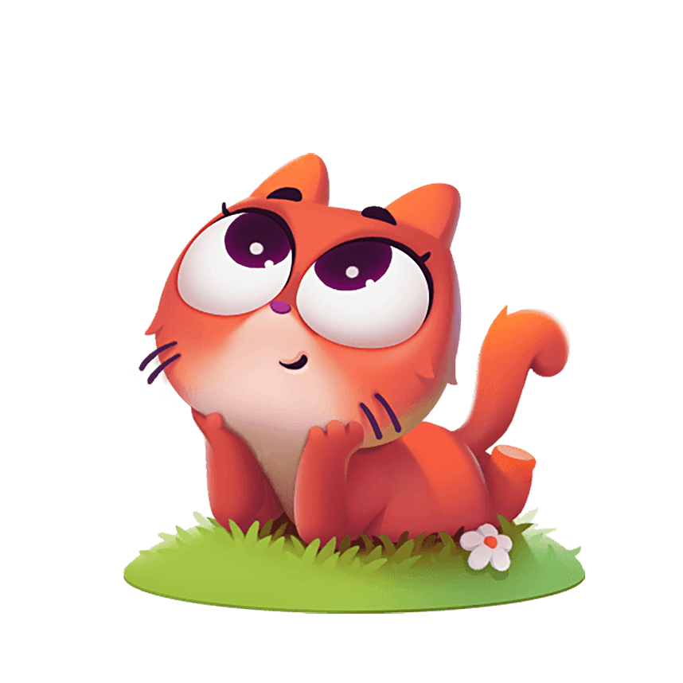
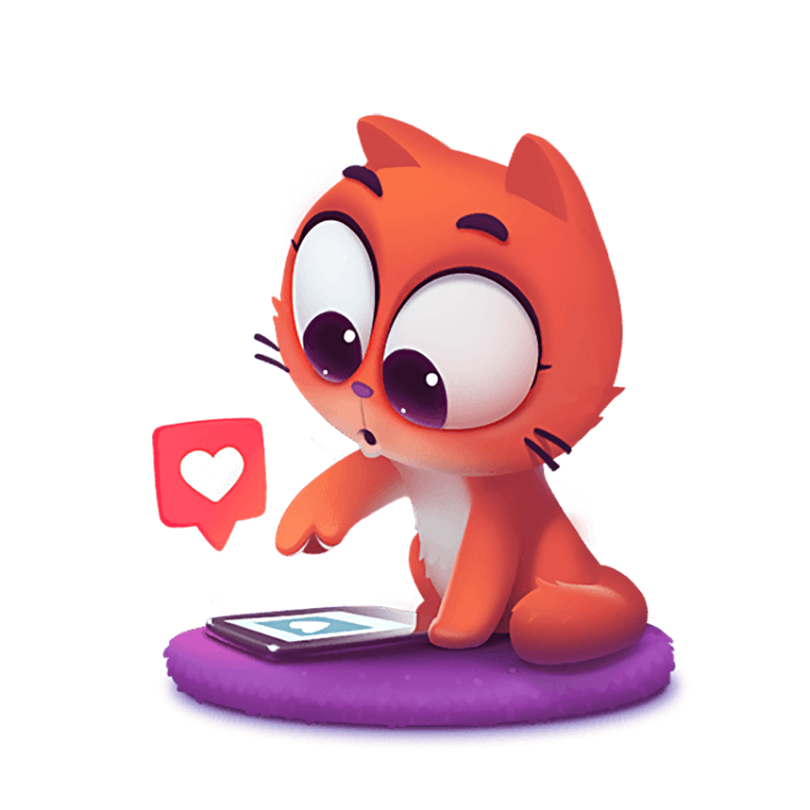
4LS
LIKED LEARNT LACKED LONGED
Notes:
Think back on the last 4 weeks and share what you Liked about it?
What new have you Learnt?
What do you think was lacking?
What were you longing for?

Slide 4
Good Luck!

